Slide 1



HACK MATRIX HACKATHON
TITLE PAGE
PROJECT TITLE : HM50 - Disaster Preparedness App
TEAM NAME : Code Quest
TEAM MEMBERS : Kripa Mehndiratta, Pragati Sachdeva, Bhumika Singh, Princy Mahajan

Slide 2

PROBLEM STATEMENT
Describe the problem clearly :
During disasters like floods, earthquakes, and heatwaves, people often lack quick access to accurate, local information. Communication systems may fail, causing confusion and delayed response.
Who is affected by this problem :
Local residents, emergency responders, authorities, and vulnerable groups like elderly and children are most affected.
Why this problem is important?
Delayed information costs lives. A centralized, AI-powered alert system can bridge the gap between official channels and on-the-ground reality.

Slide 3
EXISTING SOLUTIONS AND GAPS
List of existing Solutions (if any) :
Existing solutions include government alert systems, weather apps, and disaster management platforms like early warning systems and emergency helplines.
Mention their Limitations :
These solutions often lack real-time local updates, depend heavily on internet connectivity, and do not allow community-level reporting or coordination.
Explain the gap your project will address:
This project fills the gap by providing a localized, real-time platform where users can report incidents, receive alerts, and access offline emergency guides, ensuring better communication even during network failures.

Slide 4
PROPOSED SOLUTION
Explain your solution clearly:
A disaster app that gives real-time local updates, AI-based alerts, and an offline emergency guide.
List key features:
AI safety alerts, community incident reporting, live threat radar, India SVG map with pins, preparedness quiz. Unique because it merges citizen reporting + AI severity classification + weather in one UI. MVP is live at paniczero.onrender.com.
Explain how it solves the problem: Provides fast, local information, improves coordination, and works even without internet—helping save lives.

Slide 5
SYSTEM ARCHITECTURE
Include architecture diagram: User reports are submitted through the app → sent to the backend → stored in the database → processed and shown on the live map → AI API analyzes data and generates local alerts → users receive updates in real time (even offline via cached data)
Mention main components (Frontend, Backend, Database, APIs):
Frontend (App UI), Backend (Flask server),
Database (stores reports & alerts), APIs (AI for alerts, location services).
Explain data flow briefly:
User (App) -> Frontend (UI) -> Backend (Flask Server) -> Database (Reports Storage) -> AI API (Alert Generation) -> Frontend (Alerts + Map Display)

Slide 6
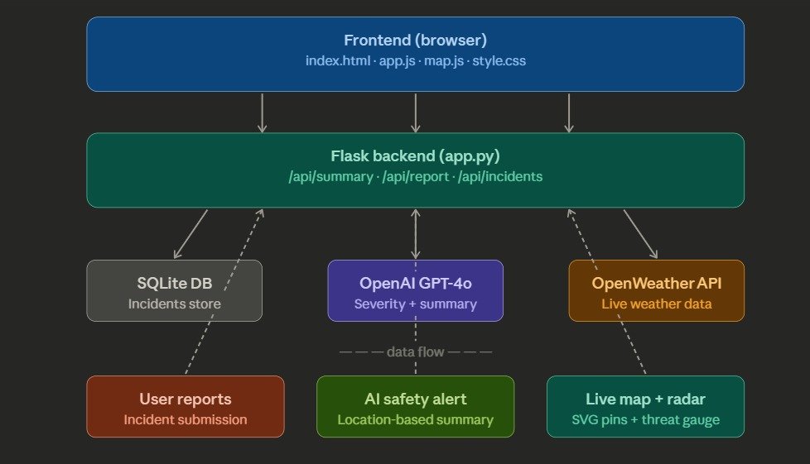
FLOWCHART / WORKING PROCESS

Slide 7
TECH STACK
Frontend technologies :
HTML5, CSS3 — structure and styling of all pages
SVG Map
Backend technologies :
Python + Flask — handles all API routes, stores reports, calls Claude API
Flask-CORS — allows frontend to talk to backend smoothly
Database:
SQLite — lightweight, no setup needed, stores incident reports and user sessions
APIs used:
OpenAI API - generates accurate, plain-English local safety summaries from community reports; reliable, well-documented, and easy to integrate with Flask in minutes

Slide 8
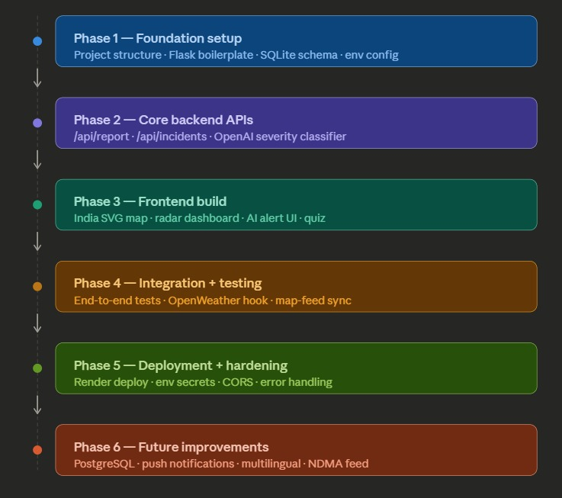
IMPLEMENTATION PLAN

Slide 9
EXPECTED OUTCOME / IMPACT
Expected results of the project :
Instant AI-generated safety summary with real-time community incident map
Emergency guide works fully offline, no internet required
Benefits to users:
Turns every citizen into an informed first responder
Simple, plain-English guidance for all ages and literacy levels
Real-world impact:
Built for India's 700+ annual disasters, scalable to any city
Designed for NDMA integration and nationwide deployment

Slide 10
FUTURE SCOPE AND CONCLUSION
Future improvements :
Multilingual support — Hindi, Marathi, Tamil for rural reach
SMS alerts for users with no smartphones
AI-powered image verification to prevent fake incident reports
Final summary :
HM50 Disaster Preparedness App is a community-powered, AI-assisted, offline-capable emergency platform that turns every citizen into an informed first responder — built in 8 hours, designed to save lives.
Scalability of the project :
Switch SQLite → PostgreSQL to handle thousands of concurrent reports

